Slide 1



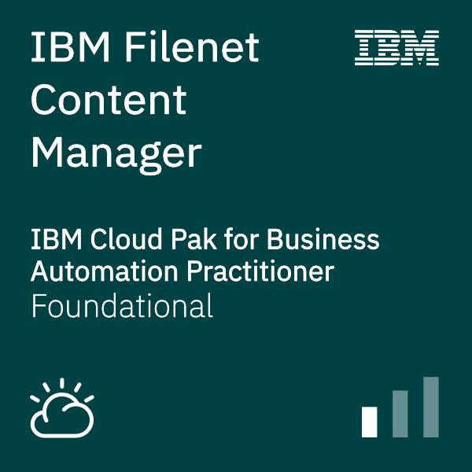
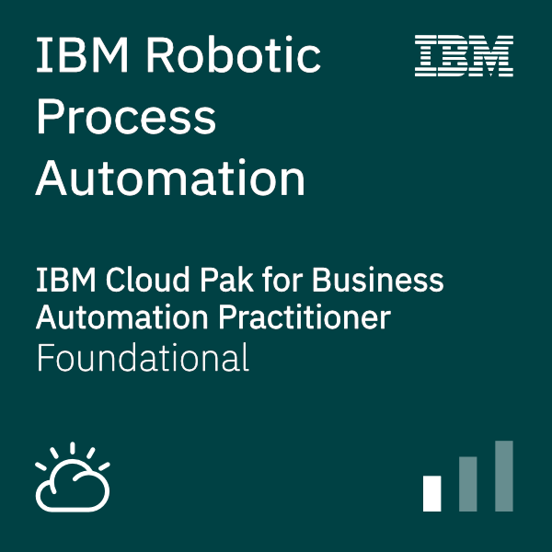



Jam Agenda – {Americas}
Activity – Time Zone GMT-4:00h (Eastern Daylight Time)
WebEx:
https://ibm.webex.com/ibm/j.php?MTID=mc466cf6e4b0f742f91619f23d01fc3bb
Day 1
AM
09:00 [All] Arrival & etc.
09:10 [Tom Al-Hamwy] Welcome Note
11:45 [All] Choose & provision scenario
09:30 [Swapnil Agrawal] Scenario Overview
PM
13:00 [All] Start scenario implementation
17:00 [Tom Al-Hamwy] Close Day 1
Day 2
AM
09:00 [Tom Al-Hamwy] Day 2 kick-off
09:30 [All] Continue scenario implementation
9:00 [Bill Lawton] Business Automation Roadmap (CP4BA)
PM
13:00 [All] Continue scenario implementation
17:00 [Tom Al-Hamwy] Close Day 2
14:00 [Owen Cline ] Workflow Process Services (WfPS)
15:00 [Paul Pacholski ] Automation Mgr. (PAM/DM)
Day 3
AM
09:00 [Tom Al-Hamwy] Day 3 kick-off
10:30 [All] Complete scenario implementation
9 :00 [Clandis Baker] Automation Document Processing (ADP)
PM
Survey: https://www.surveymonkey.com/r/CP4BATechJam2022
15:00 [Tom Al-Hamwy] Feedback / Open Discussion / Q&A & Closure
IBM Software | © 2022 IBM Corporation

